Slide 1
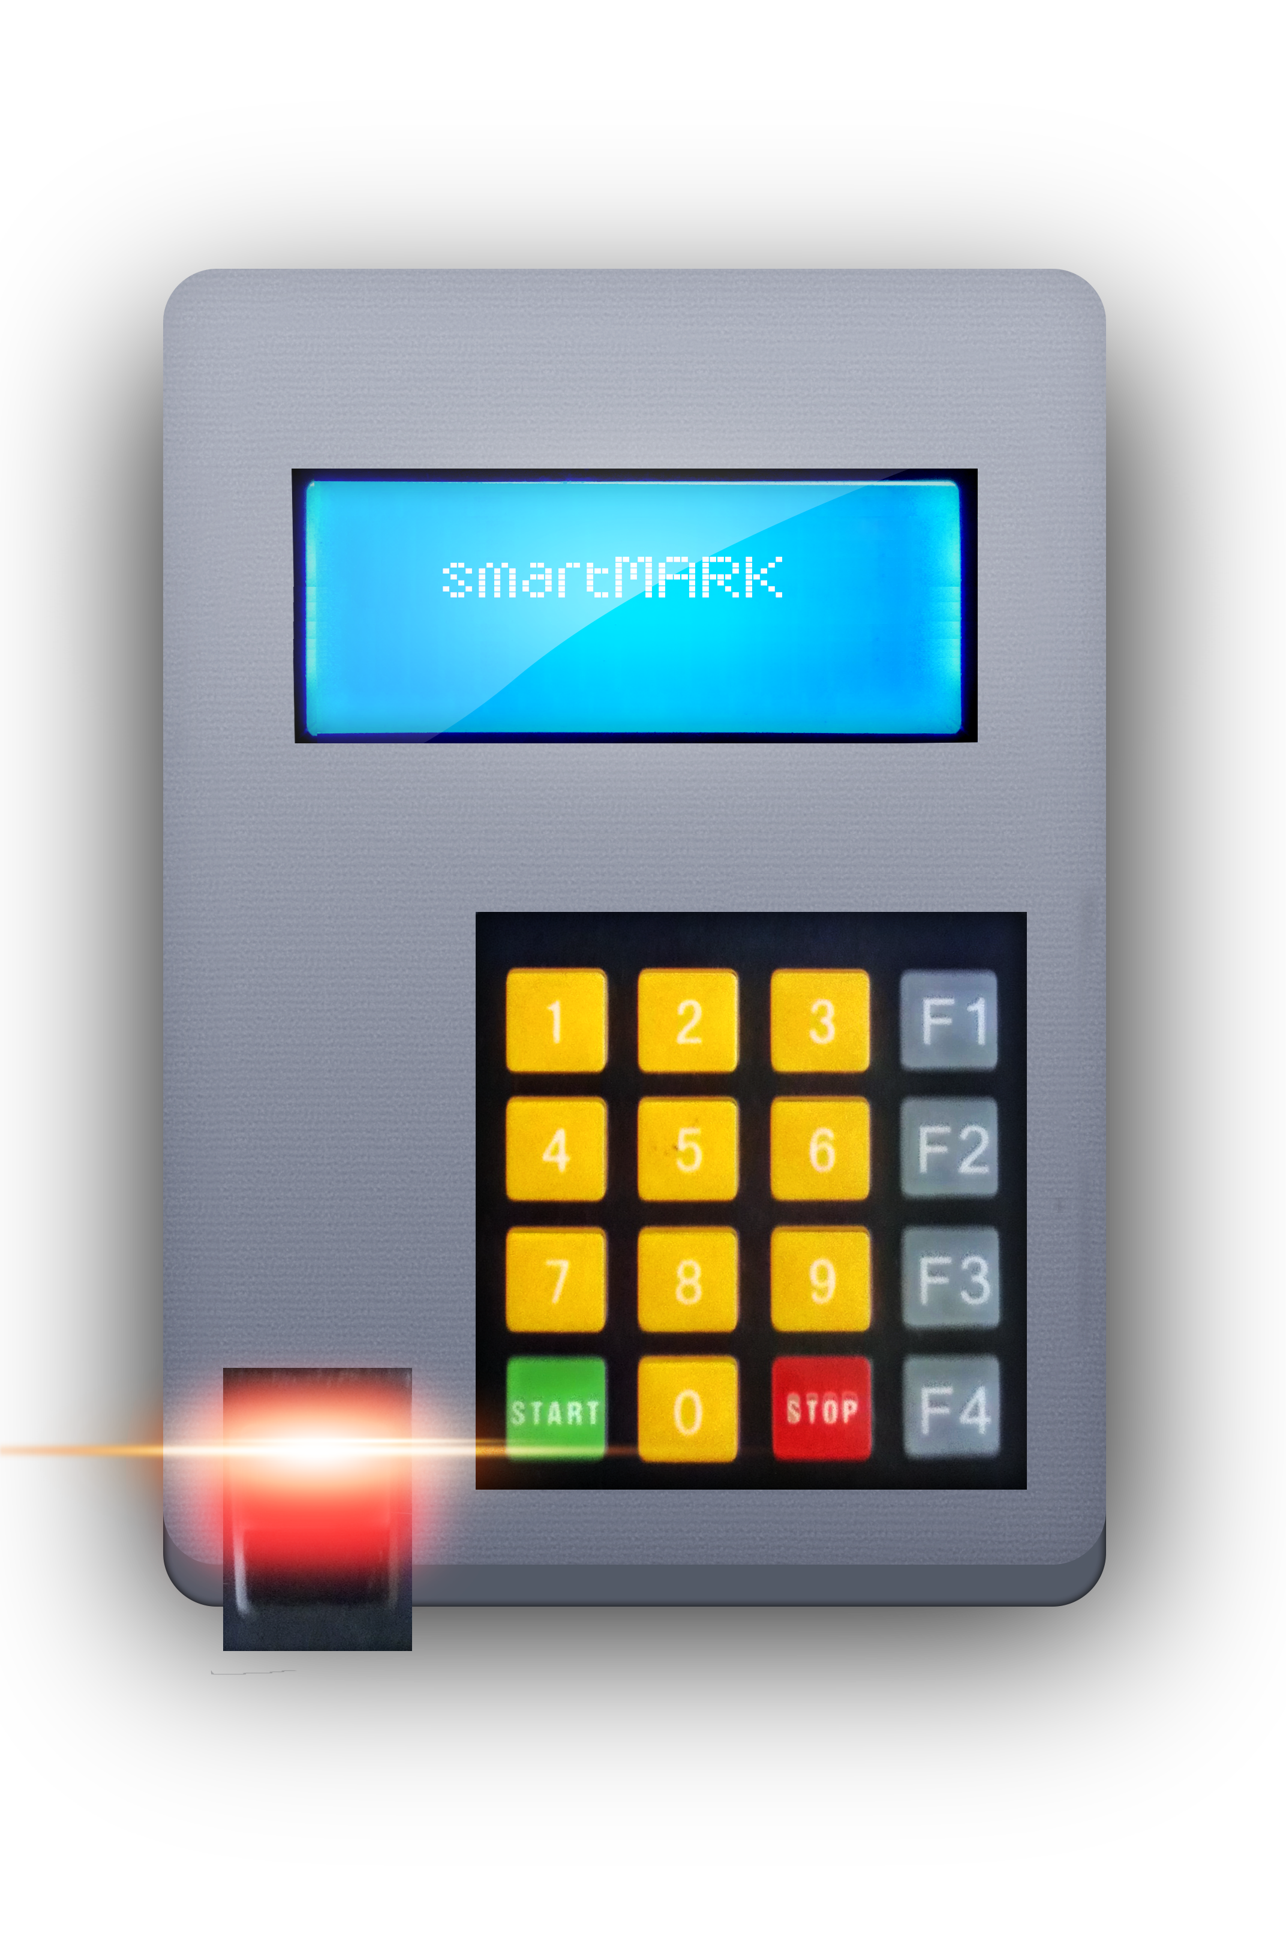
smart MARK
Mark your attendance Smart

Slide 2
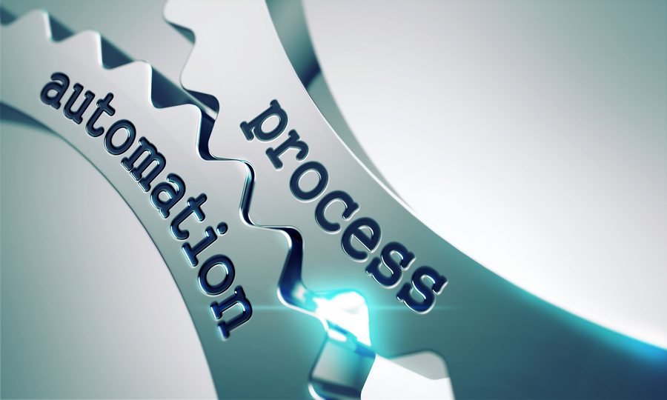

Abstract
Today the attendance marking in institutions happen manually. We see it wastes many productive hours because of huge paper work and also it is less accurate due to some cheating students who sign for others. We are going to address mainly these 2 problems. Although we see some of the devices in today’s market they have security issues, not wireless, not partable, not analyzing data after taking the attendance etc. Here in, we have addressed all these problems from one device. Our future plan is to put this into the market by enhancing security issues further and to fully automate the attendance marking.
smart MARK

Slide 3

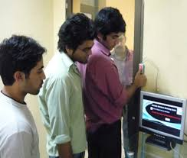
Problem?
Today the attendance marking in institutions happen manually. We see it wastes many productive hours because of huge paper work and also it is less accurate due to some cheating students who sign for others.
Solution?
Create a fully automated device with all functions in today’s manual attendance marking in institutions with the special features such as high security,wireless,portable etc.
smart MARK

Slide 4
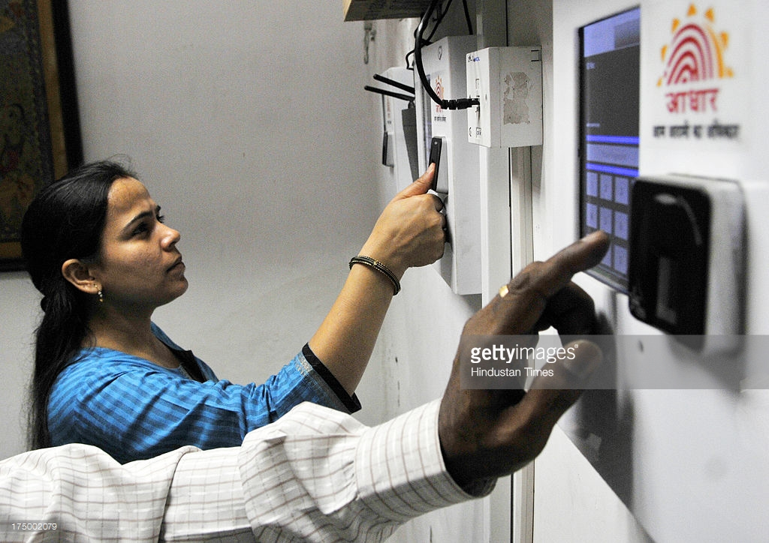
There are biometric fingerprint attendance marking systems. But they are…..
they have less security
Not portable always. Most of them Stationary
Not analysing data after taking the attendance.
not easy to use
smart MARK

Slide 5
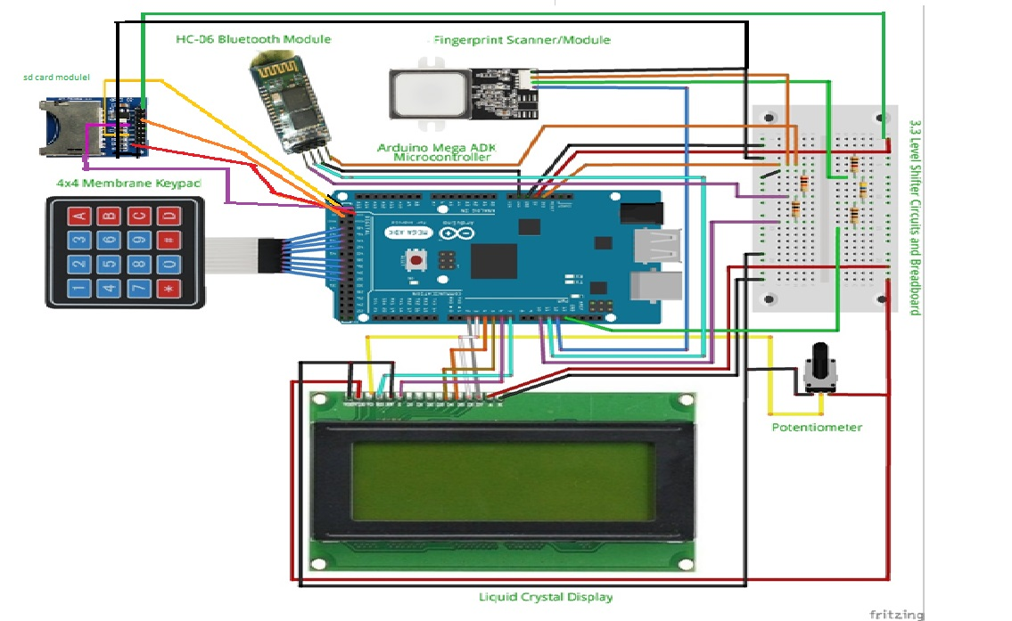
System model/Implementation
Hardware:
Arduino Mega : number of I/O Devices ( Pins ) and memory sizes matters
4 x 4 keypad : enable customer to deal with device
Bluetooth Module : Transfer data wireless to Attendance
Management System(Software)
Fingerprint device: dealing with user’s fingerprints
LiquidCrystal Display :enables customer to interact with device
SD card/Module: saving data (fingerprint data, Encrypted users data, Metadata)
Software :-
get data from the fingerprint sensor and
Store in a database
When students have low attendance it autogenerates emails to students,course coordinators as alerts.
Technologies:-C#,mySQL,Arduino libraries,adafruit library for fingerprint sensor
smart MARK

Slide 6

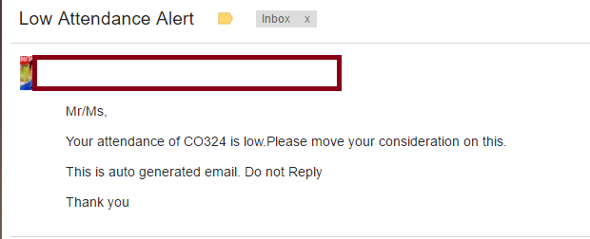
Results
Autogenerate emails as alerts when students have low attenadance.
smart MARK

Slide 7
Conclusion and Future Work:-
As the conclusion we can say that we have successfully addressed all the solutions for the problem that led to introduce this device.
Our future plan is to address all kind of security issues, and giving 100 % accuracy when taking attendance (in case of not identifying the finger already enrolled user)and to fully automate the attendance marking.
smart MARK

